Slide 1

Book Recommendation System
Madhavi Devi Rockandla

Slide 2

Passion Project – Book Recommendation System
In Book recommendation system user can give different user inputs based on ratings of book and return recommendation of books. If it is existing user, the recommendations would be based the user earlier inputs. Will be doing 3 recommendation system Content-Based Filtering, Collaborative Filtering and combination of both (Hybrid Filtering).

Slide 3
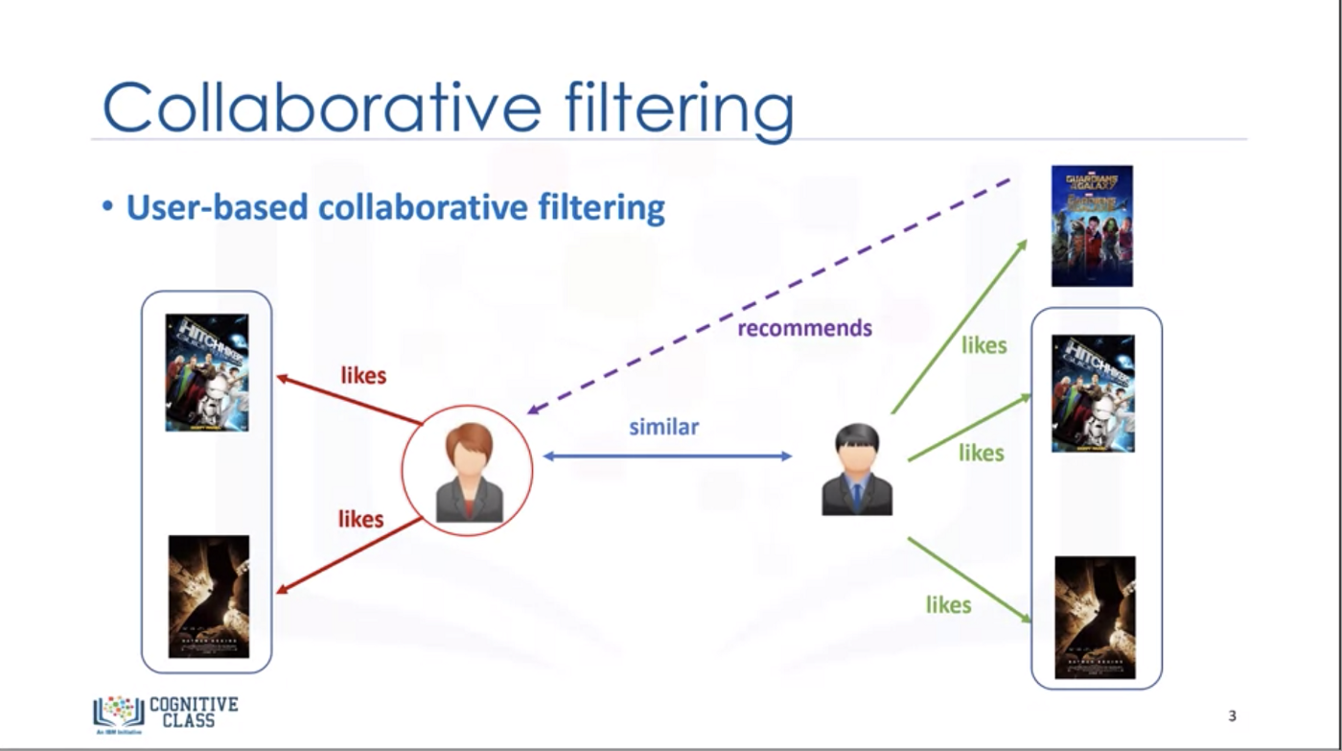
Collaborative Filtering
User Based

Slide 4
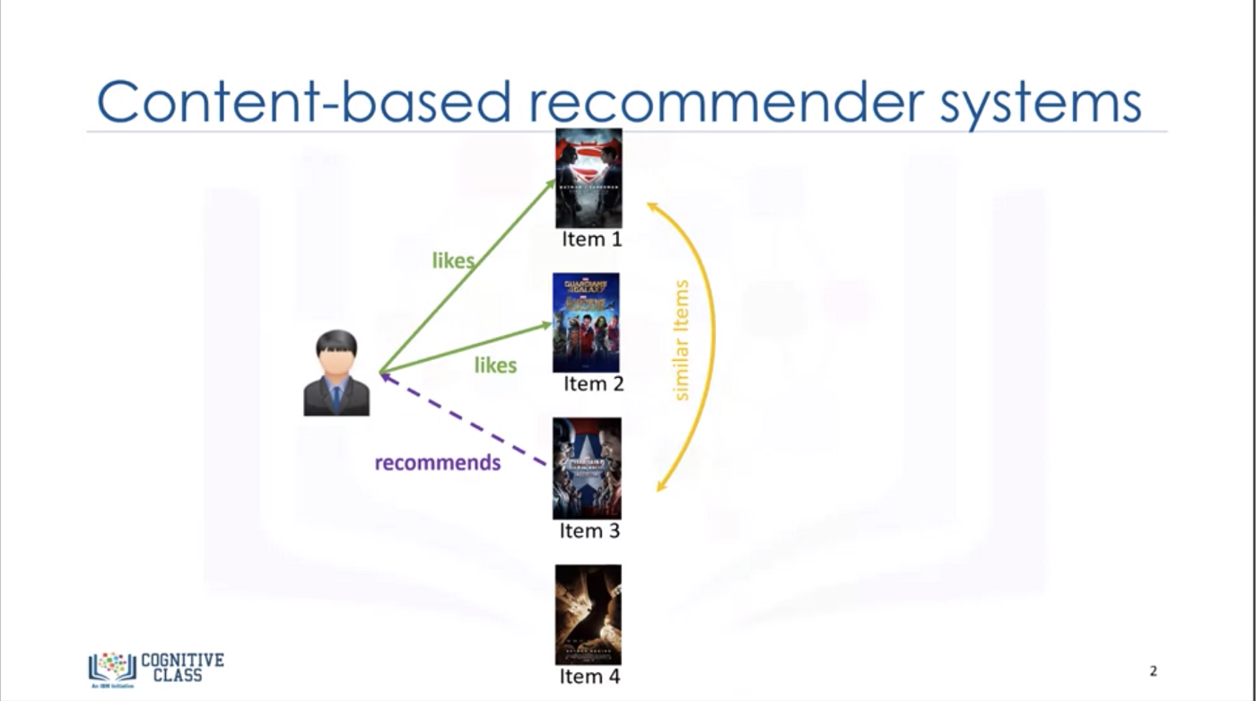
Content-Based Recommendation

Slide 5
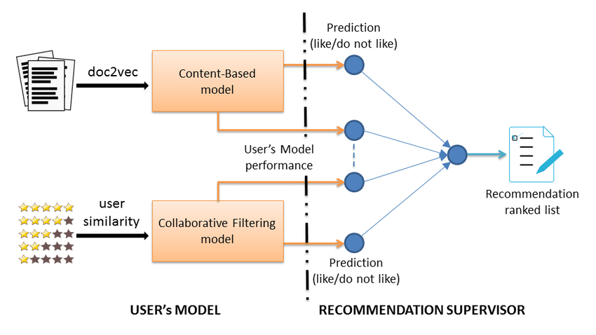
Hybrid Filtering

Slide 6
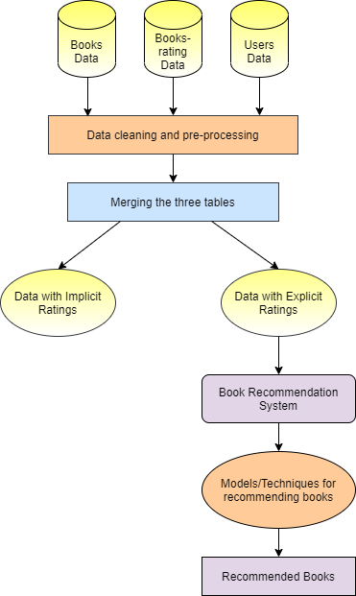
Workflow
Dataset used for this project
https://www.kaggle.com/datasets/arashnic/book-recommendation-dataset

Slide 7
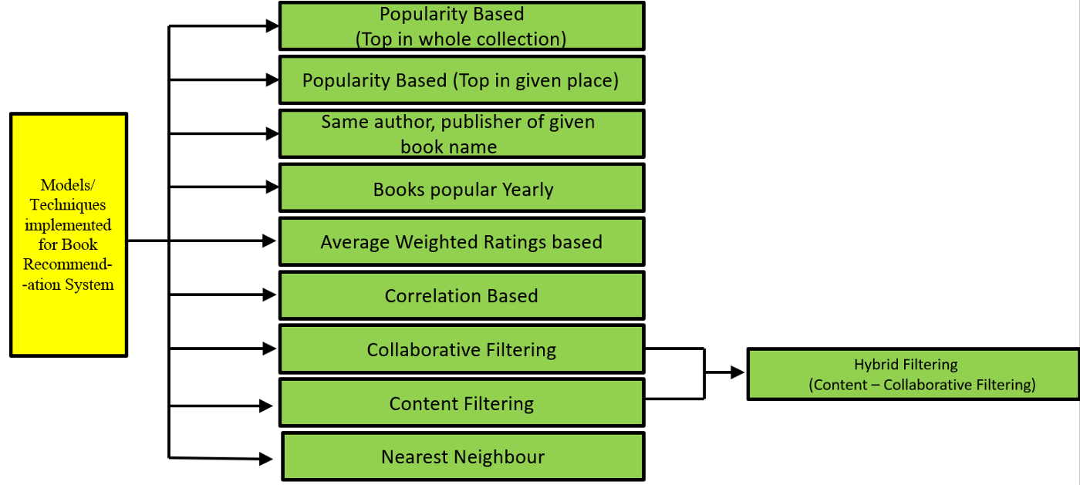
Recommendation Model

Slide 8
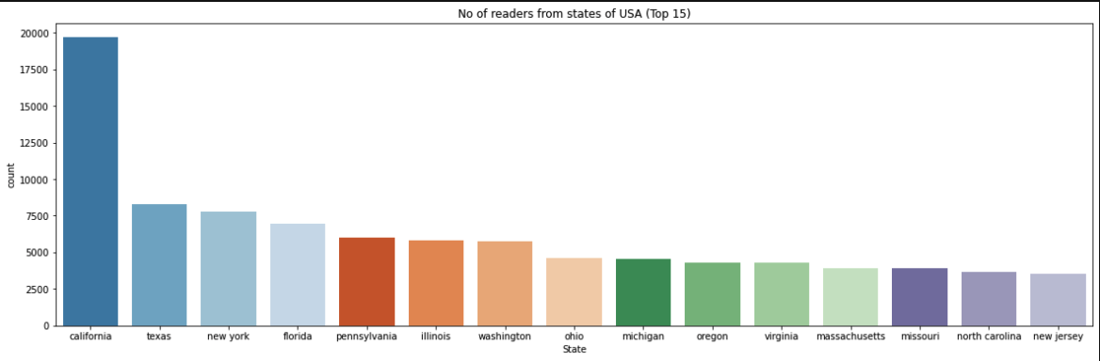
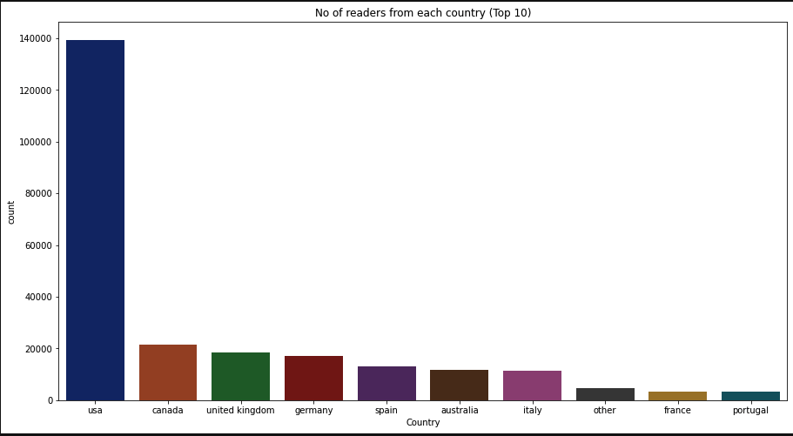
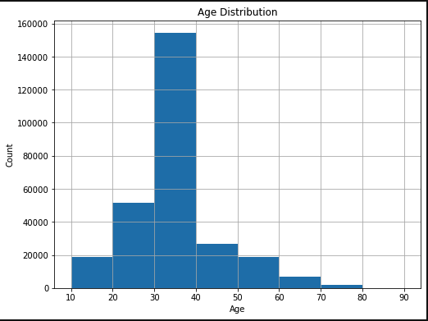
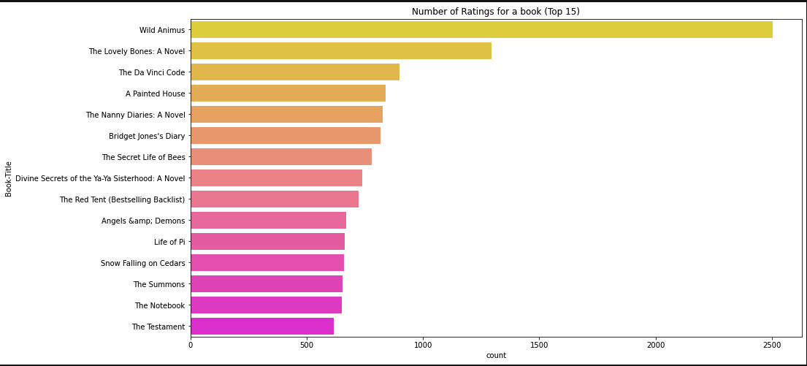
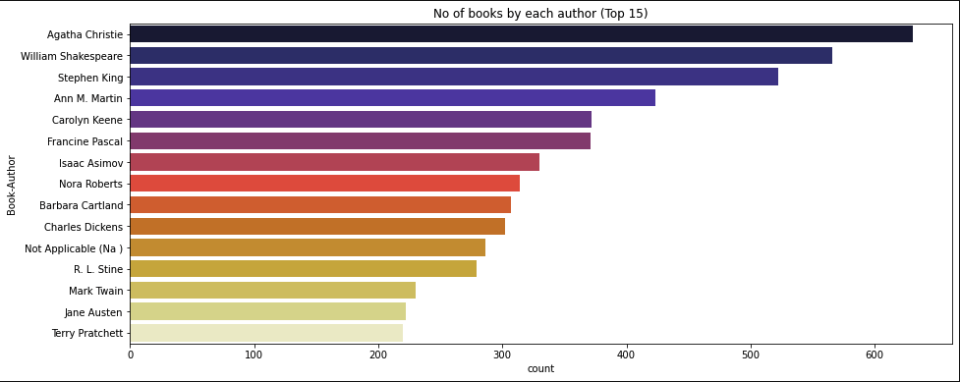
Data Visualization – Jupyter Notebook

Slide 9

Home Page

Slide 10

Login Page

Slide 11
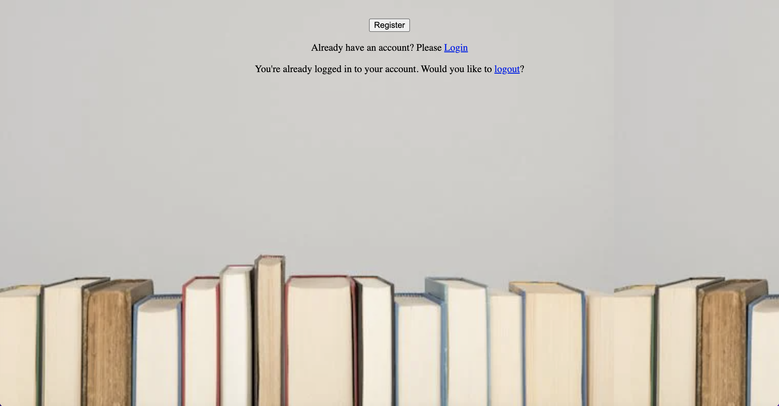
Register Page

Slide 12
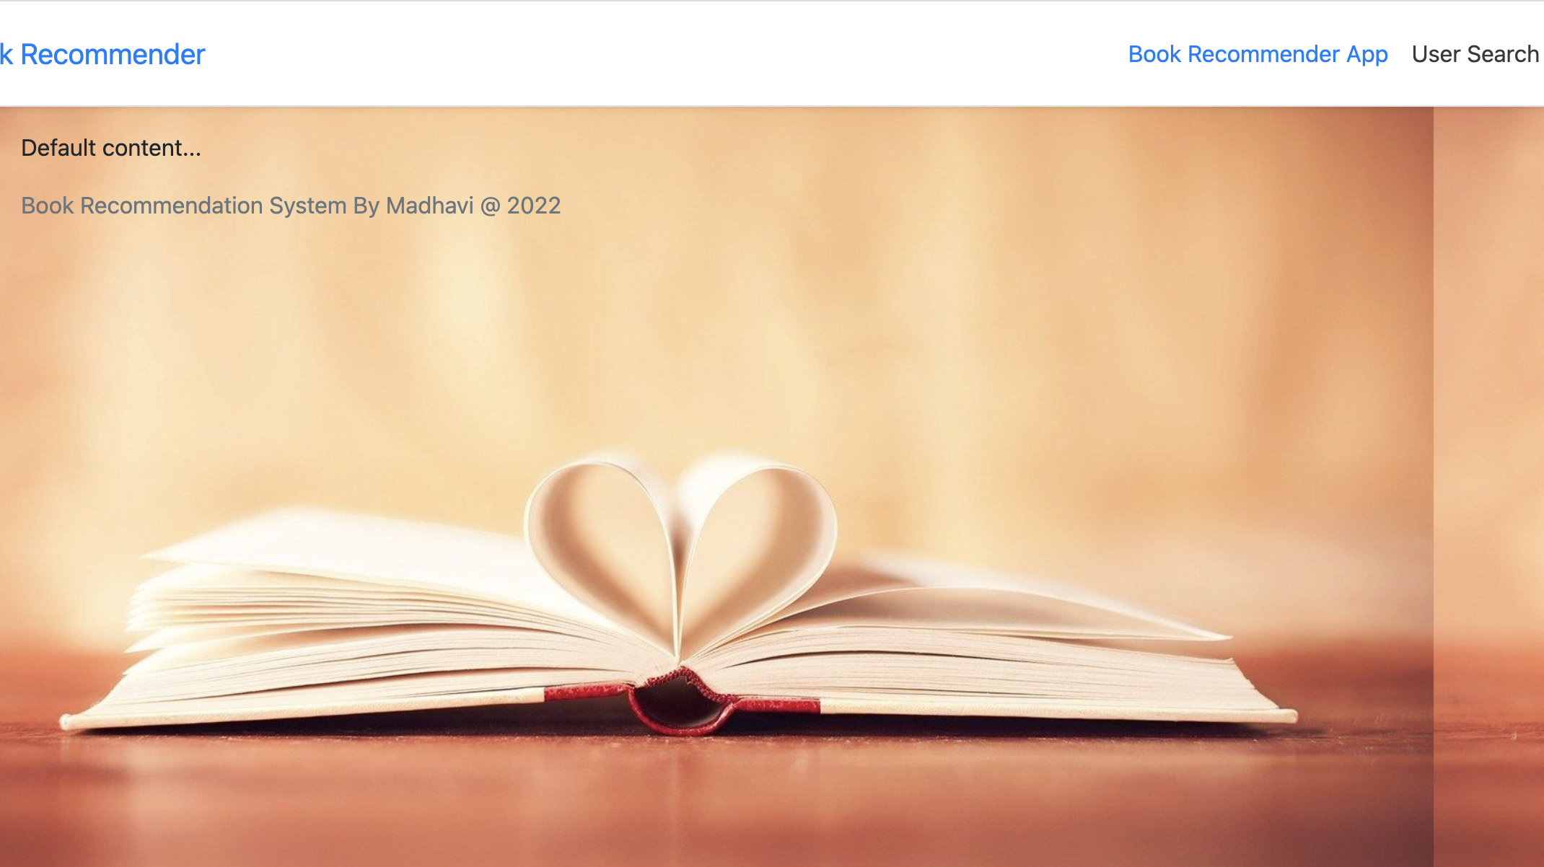
Base Page

Slide 13
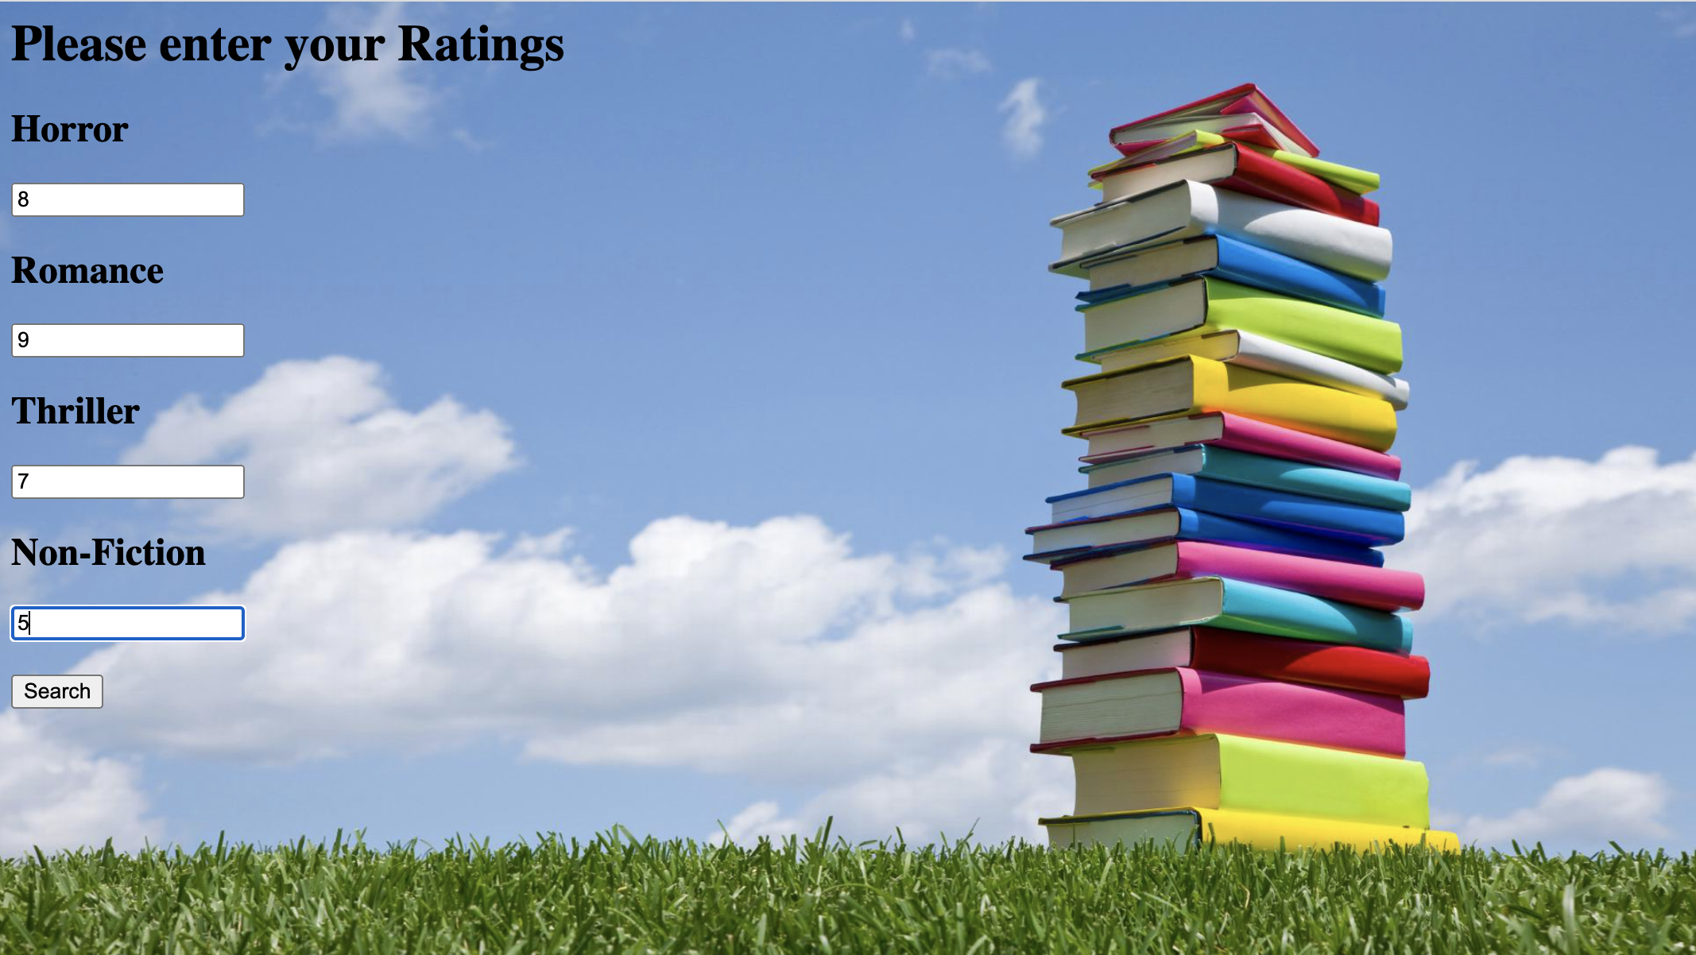
Enter Ratings Page

Slide 14
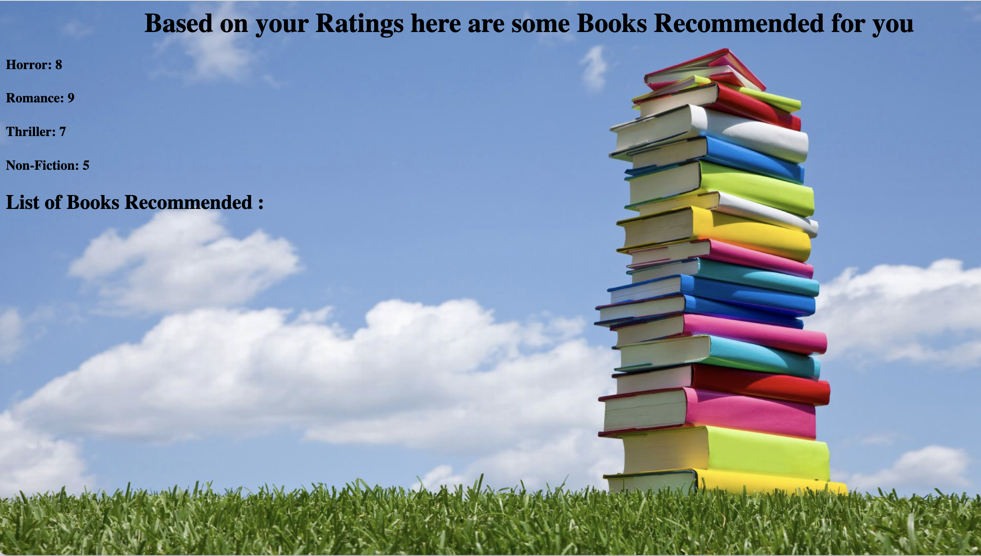
List of Books Based on Ratings

Slide 15
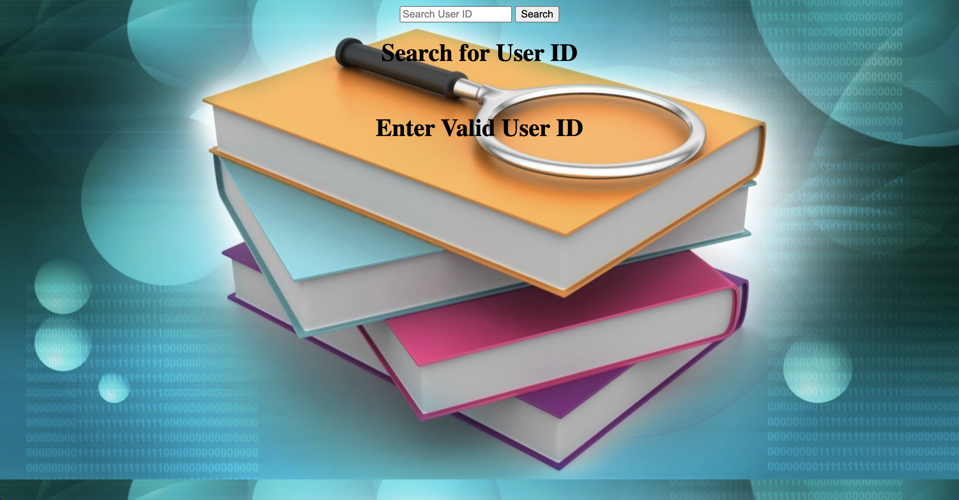
Search Books Based on Books User ID

Slide 16

About Page

Slide 17

Logout Page

Slide 18

Thank You

